Slide 1
CS-2001 Data Structures
Fall’25
Week # 02
OOP revision, Rule of three

Slide 2
Agenda
Dynamic memory management
constructors, destructors
copy constructor and assignment operator
their usage and issues
function pointers in classes

Slide 3
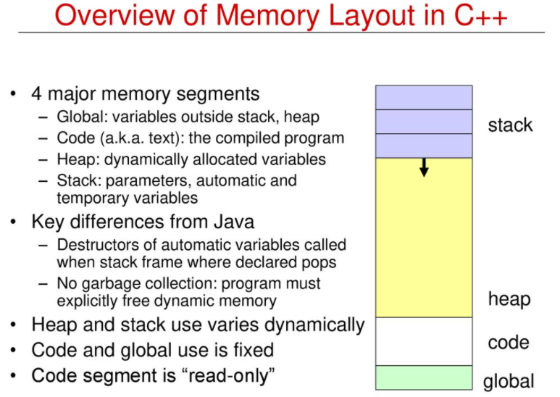

Slide 4
Dynamic Memory Management
Refers to performing memory allocation manually by programmer.
Dynamically allocated memory is allocated on Heap and non-static and local variables get memory allocated on Stack.
Why ?
We are free to allocate and deallocate memory whenever we need and whenever we don’t need anymore. There are many cases where this flexibility helps. Examples of such cases are Linked List, Tree, etc.
How?
Malloc()/Calloc()
New/delete

Slide 5
Normal Vs Dynamically allocated memory
For normal variables like “int a”, “char str[10]”, etc, memory is automatically allocated and deallocated.
For dynamically allocated memory like “int *p = new int[10]”, it is programmers responsibility to deallocate memory when no longer needed.
Memory Leak:
Memory leak occurs when programmers create a memory in heap and forget to delete it.
it reduces the performance of the computer by reducing the amount of available memory.

Slide 6
Malloc()/calloc()
library functions that allocate memory dynamically on runtime.
a pointer to the block of memory is returned otherwise NULL value is returned which indicates the failure of allocation.
malloc() doesn’t initialize the allocated memory while calloc() allocates the memory and also initializes the allocated memory block to zero.
void* malloc(size_t size);
void* calloc(size_t num, size_t size);

Slide 7
New/ delete
C++ supports malloc/calloc functions and also has two operators new and delete that perform the task of allocating and freeing the memory in a better and easier way.
new operator initializes the memory and returns the address of the newly allocated and initialized memory to the pointer variable.
int *p = new int; (declaring)
int *p = new int(25); (initializing)
float *q = new float(75.25);
int *p = new int[10] (allocation of array)
normal arrays are deallocated by compiler,dynamically allocated arrays always remain there until either they are deallocated by programmer or program terminates
delete p;
delete[] p; (freeing array)

Slide 8
Delete vs free
delete operator should only be used either for the pointers pointing to the memory allocated using new operator or for a NULL pointer, and free() should only be used either for the pointers pointing to the memory allocated using malloc() or for a NULL pointer.
The most important reason why free() should not be used for de-allocating memory allocated using NEW is that, it does not call the destructor of that object while delete operator does.
Notes:
Dltvsfree.cpp

Slide 9
Lets see some coding examples.
New/ delete: newdlt.cpp
Dynamic Memory Allocation for Arrays: DMAA.cpp
Dynamic Memory Allocation for Objects
:DMAO.cpp

Slide 10
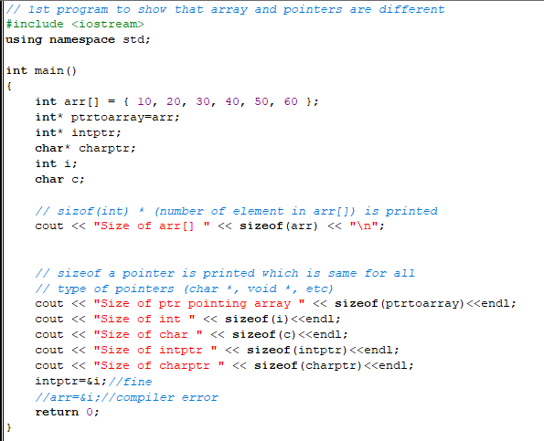
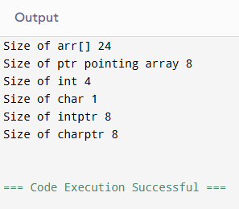
Code snippets and outputs

Slide 11
Constructors
They should be declared in the public section
They do not have any return type, not even void
They get automatically invoked when the objects are created
They cannot be inherited though derived class can call the base class constructor
Like other functions, they can have default arguments
You cannot refer to their address
Constructors cannot be virtual

Slide 12
Types of constructors
Default constructor is the constructor which doesn’t take any argument. It has no parameters.
Parameterized constructor: It is possible to pass arguments to constructors. Typically, these arguments help initialize an object when it is created.
Copy constructor: A copy constructor is a member function which initializes an object using another object of the same class.

Slide 13
Copy constructor vs assignment operator
Copy constructor is called when a new object is created from an existing object, as a copy of the existing object.
Assignment operator is called when an already initialized object is assigned a new value from another existing object.
Refer to typesofconstructors.cpp

Slide 14
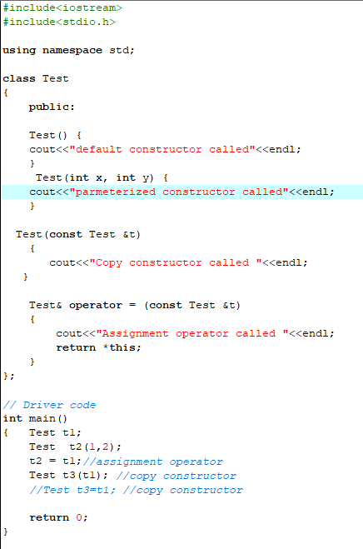
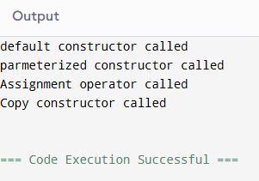
typesofconstructors.cpp

Slide 15
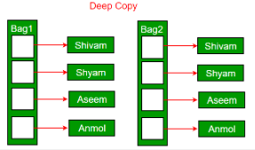
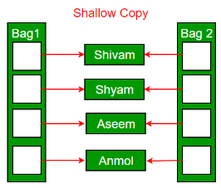
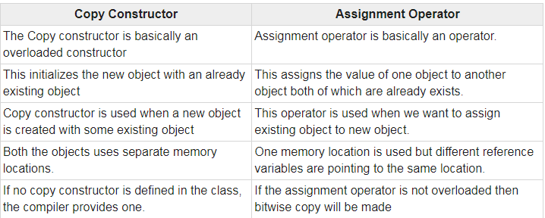
Deep copy vs shallow copy

Slide 16
Destructor:
Destructor is a member function which destructs or deletes an object.
Destructor function is automatically invoked when the objects are destroyed.
It cannot be declared static or const.
The destructor does not have arguments.
It has no return type not even void.
A destructor should be declared in the public section of the class.
The programmer cannot access the address of destructor.
There can only one destructor in a class with class name preceded by ~, no parameters and no return type.
The main reason of a destructor is to wipe of all the data members initialize by a constructor and the object life cycle.
Notes:
If we do not write our own destructor in class, compiler creates a default destructor for us. The default destructor works fine unless we have dynamically allocated memory or pointer in class. When a class contains a pointer to memory allocated in class, we should write a destructor to release memory before the class instance is destroyed. This must be done to avoid memory leak.
Can a destructor be virtual?
Yes, In fact, it is always a good idea to make destructors virtual in base class when we have a virtual function.
When does the destructor get called?
A destructor is automatically called when:
1) The program finished execution.
2) When a scope (the { } parenthesis) containing local variable ends.
3) When you call the delete operator.

Slide 17
Initializer list
Initializer List is used in initializing the data members of a class. The list of members to be initialized is indicated with constructor as a comma-separated list followed by a colon.
Point(int i = 0, int j = 0):x(i), y(j) {}
constructor can be written as:
Point(int i = 0, int j = 0) {
x = i;
y = j;
}

Slide 18
Rule of three
This rule basically states that if a class defines one (or more) of the following, it should explicitly define all three:
  destructor
  copy constructor
  copy assignment operator
  The default constructors and assignment operators do shallow copy and we create our own constructor and assignment operators when we need to perform a deep copy (For example when a class contains pointers pointing to dynamically allocated resources).

Slide 19
Example
Now, suppose our class does not have a copy constructor. Copying an object will copy all of its data members to the target object. In this case when the object is destroyed the destructor runs twice. Also the destructor has the same information for each object being destroyed. In the absence of an appropriately defined copy constructor, the destructor is executed twice when it should only execute once. This duplicate execution is a source for trouble.
Refer to ruleofthree.cpp
Notes:
In the example above, once the program goes out of scope, the class destructor is called, not once but twice. First due to deletion of a1 and then of a2. The default copy constructor makes a copy of the pointer vals and does not allocate memory for it. Thus, on deletion of a1, the destructor frees vals. All subsequent vals containing instances when trying to be deleted by the destructor causes the program to crash, as vals do not exist anymore.

Slide 20
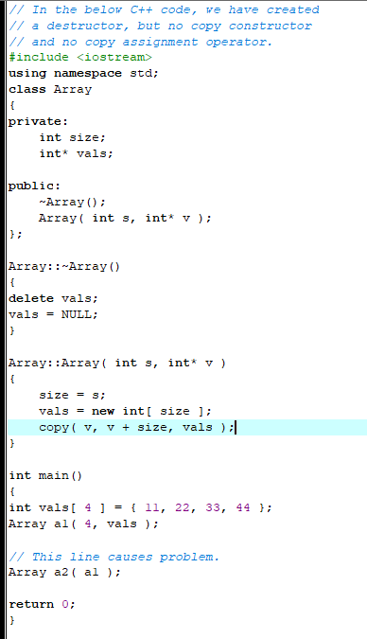
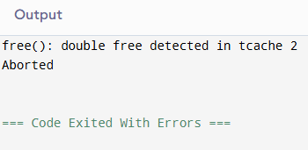
ruleofthree.cpp

Slide 21
Function pointers
self revision. Oop concepts. Pointers etc.

